Slide 1
Computação Reconfigurável
Aula 2
Valeri Skliarov, Prof. Catedrático
Email: skl@ua.pt
URL: http://sweet.ua.pt/skl/
Departamento de Eletrónica, Telecomunicações e Informática
Universidade de Aveiro
http://elearning.ua.pt/

Slide 2

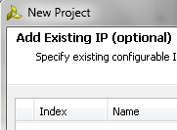
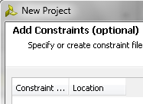
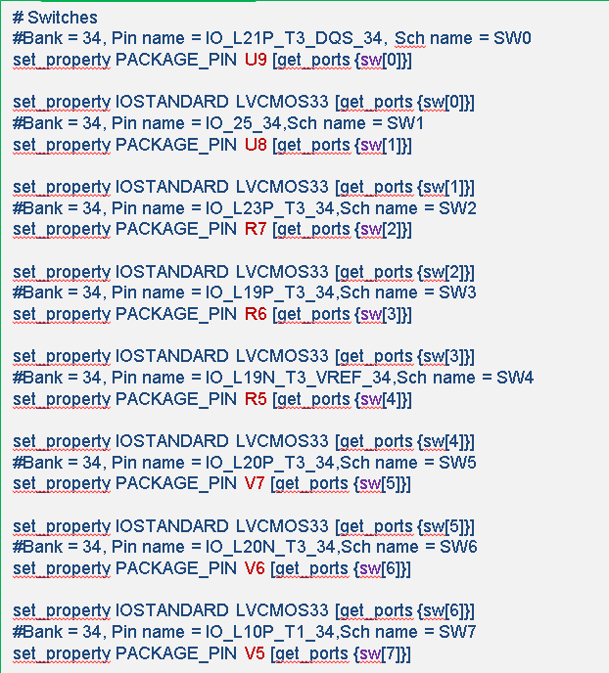
Revisão da aula anterior
Primeiros passos:
library IEEE;
use IEEE.STD_LOGIC_1164.ALL;
entity TopTrivial is
port ( sw : in std_logic_vector (15 downto 0);
led : out std_logic_vector (15 downto 0));
end TopTrivial;
architecture Behavioral of TopTrivial is
begin
led <= sw;
end Behavioral;

Slide 3
Aula 2
Síntese e simulação
Tipos de dados, objetos e operadores
Instruções de controlo – decisão: if, when, with, case
Processos combinatórios e sequenciais
VHDL comportamental e estrutural
Exemplos:
Operações aritméticas
Processos
Conversão de tipos
Bibliografia: V.Sklyarov, I.Skliarova, A.Barkalov, L.Titarenko. Synthesis and Optimization of FPGA-Based Systems. Springer, 2014.

Slide 4
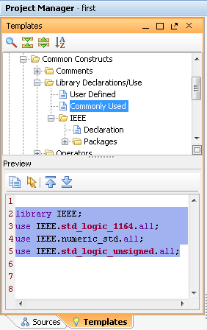
VHDL (três partes principais)
Três partes principais:
library IEEE;
use IEEE.STD_LOGIC_1164.all;
entity TopTrivial is
port ( sw : in std_logic_vector (15 downto 0);
led : out std_logic_vector (15 downto 0));
end TopTrivial;
architecture Behavioral of TopTrivial is
begin
led <= sw;
end Behavioral;
Incluir bibliotecas necessárias
Declarar entidade
Descrever arquitetura
Bibliotecas mais comuns:
library IEEE;
use IEEE.STD_LOGIC_1164.all;
use IEEE.STD_LOGIC_ARITH.all;
use IEEE.STD_LOGIC_UNSIGNED.all;
library IEEE;
use IEEE.std_logic_1164.all;
use IEEE.numeric_std.all;
use IEEE.std_logic_unsigned.all;
ou

Slide 5
VHDL (três tipos de descrição principais)
VHDL:
Comportamental.
Estrutural.
Misto
library IEEE;
use IEEE.STD_LOGIC_1164.all;
entity TopTrivialNew is
port ( clk : in std_logic;
sw : in std_logic_vector (15 downto 0);
led : out std_logic_vector (15 downto 0));
end TopTrivialNew;
architecture my of TopTrivialNew is
signal divided_clk : std_logic;
begin
led <= sw when divided_clk = '1' else (others => '0');
div : entity work.clock_divider
port map( clk, '0', divided_clk);
end my;
Declaração de sinais
Frequência do relógio da placa 100 MHz

Slide 6
VHDL (sumário)
Declaração de bibliotecas
library . . .
use . . .
library IEEE;
use IEEE.STD_LOGIC_1164.all;
use IEEE.STD_LOGIC_ARITH.all;
use IEEE.STD_LOGIC_UNSIGNED.all;
library IEEE;
use IEEE.std_logic_1164.all;
use IEEE.numeric_std.all;
use IEEE.std_logic_unsigned.all;
parte declarativa de entidade
Descrição de entidade (interface)
entity <nome de entidade> is
Declaração de parâmetros genéricos – generic
Declaração de portas – port
end <nome de entidade>
entity Counter is
generic (N : integer := 3);
port (
reset : in std_logic;
clk : in std_logic;
My_count: out std_logic_vector(N downto 0)
);
end Counter;
Descrição de arquitetura (funcionalidade)
arquitecture <nome de arquitetura > of <nome de entidade> is
Declaração de sinais– signal
Declaração de constantes – constant
Declaração de tipos– type
Declaração de componentes– component
Declaração de funções– function
Declaração de procedimentos– procedure
Declaração de variáveis partilhadas– shared variable
begin
Corpo de arquitetura
end <nome de arquitetura >
Estrutural
Mista
Comportamental
parte declarativa de arquitetura

Slide 7
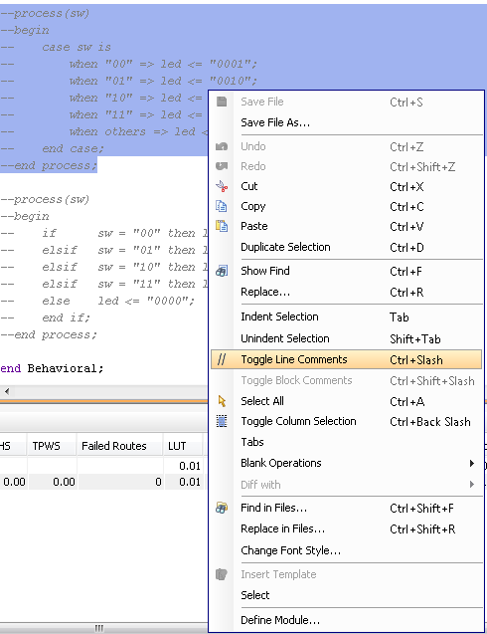
-- comentários até final da linha
Inserir/remover comentários para um conjunto de linhas

Slide 8
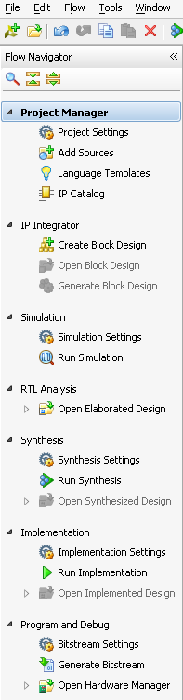
Síntese e simulação
library IEEE;
use IEEE.STD_LOGIC_1164.all;
entity TopTrivial is
port ( sw : in std_logic_vector (15 downto 0);
led : out std_logic_vector (15 downto 0));
end TopTrivial;
architecture Behavioral of TopTrivial is
begin
led <= sw;
end Behavioral;
Simulação comportamental
por exemplo:
Geralmente vai precisar de duas partes:
Código VHDL de que queremos simular;
Código VHDL adicional que se chama testbench.
Síntese, implementação e teste

Slide 9
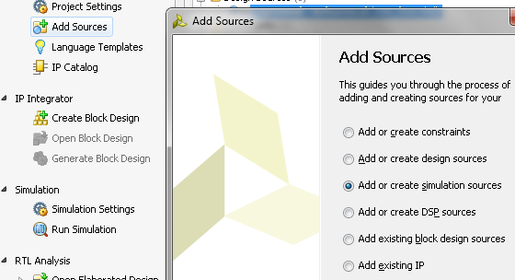
Simulação. Exemplo 1.
library IEEE;
use IEEE.std_logic_1164.all;
entity for_example is
end for_example;
architecture behavior of for_example is
signal sw_in : std_logic_vector (15 downto 0);
signal led_out : std_logic_vector (15 downto 0);
component TopTrivial
port ( sw : in STD_LOGIC_VECTOR (15 downto 0);
led : out STD_LOGIC_VECTOR (15 downto 0));
end component;
begin
uut: TopTrivial
port map (sw => sw_in, led => led_out);
stim_proc: process
begin
sw_in <= (others => '1'); wait for 50 ns;
sw_in <= (others => '1'); wait for 100 ns;
sw_in <= (15 downto 10 => '1', others => '0'); wait for 50 ns;
sw_in <= "1010101010101010"; wait for 70 ns;
sw_in <= (15 downto 13 => '1',10 => '1', 6 downto 5 => '1', others => '0');
end process;
end behavior;
Testbench
library IEEE;
use IEEE.STD_LOGIC_1164.all;
entity TopTrivial is
port ( sw : in std_logic_vector (15 downto 0);
led : out std_logic_vector (15 downto 0));
end TopTrivial;
architecture Behavioral of TopTrivial is
begin
led <= sw;
end Behavioral;
1
2

Slide 10
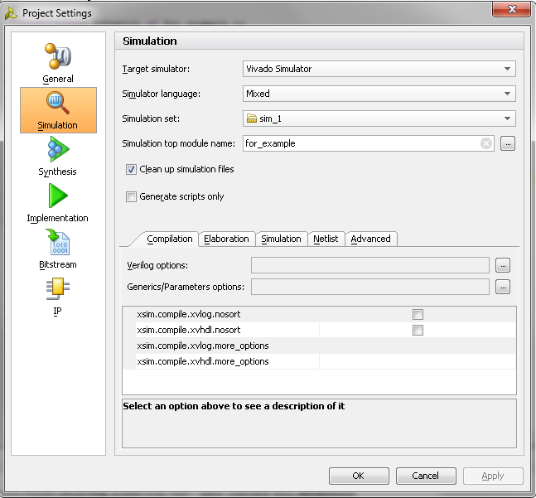
library IEEE;
use IEEE.STD_LOGIC_1164.all;
entity TopTrivial is
port ( sw : in std_logic_vector (15 downto 0);
led : out std_logic_vector (15 downto 0));
end TopTrivial;
architecture Behavioral of TopTrivial is
begin
led <= sw;
end Behavioral;
library IEEE;
use IEEE.std_logic_1164.all;
entity for_example is
end for_example;
architecture behavior of for_example is
signal sw_in : std_logic_vector (15 downto 0);
signal led_out : std_logic_vector (15 downto 0);
component TopTrivial
port ( sw : in STD_LOGIC_VECTOR (15 downto 0);
led : out STD_LOGIC_VECTOR (15 downto 0));
end component;
begin
uut: TopTrivial
port map (sw => sw_in, led => led_out);
stim_proc: process
begin
sw_in <= (others => '1'); wait for 50 ns;
sw_in <= (others => '1'); wait for 100 ns;
sw_in <= (15 downto 10 => '1', others => '0'); wait for 50 ns;
sw_in <= "1010101010101010"; wait for 70 ns;
sw_in <= (15 downto 13 => '1',10 => '1', 6 downto 5 => '1', others => '0');
end process;
end behavior;
Testbench

Slide 11

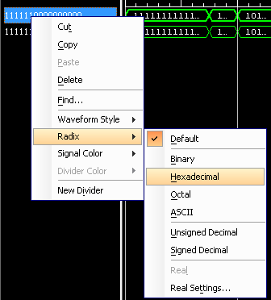

Slide 12
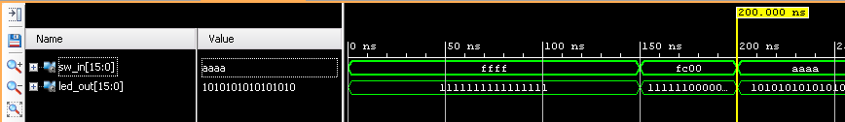
library IEEE;
use IEEE.std_logic_1164.all;
entity for_example is
end for_example;
architecture behavior of for_example is
signal sw_in : std_logic_vector (15 downto 0);
signal led_out : std_logic_vector (15 downto 0);
component TopTrivial
port ( sw : in STD_LOGIC_VECTOR (15 downto 0);
led : out STD_LOGIC_VECTOR (15 downto 0));
end component;
begin
uut: TopTrivial
port map (sw => sw_in, led => led_out);
stim_proc: process
begin
sw_in <= (others => '1'); wait for 50 ns;
sw_in <= (others => '1'); wait for 100 ns;
sw_in <= (15 downto 10 => '1', others => '0'); wait for 50 ns;
sw_in <= "1010101010101010"; wait for 70 ns;
sw_in <= (15 downto 13 => '1',10 => '1', 6 downto 5 => '1', others => '0');
end process;
end behavior;

Slide 13
Pode alterar o código da seguinte forma:
library IEEE;
use IEEE.std_logic_1164.all;
library xil_defaultlib;
entity for_example is
end for_example;
architecture behavior of for_example is
signal sw_in : std_logic_vector (15 downto 0);
signal led_out : std_logic_vector (15 downto 0);
component TopTrivial
port ( sw : in STD_LOGIC_VECTOR (15 downto 0);
led : out STD_LOGIC_VECTOR (15 downto 0));
end component;
begin
uut: TopTrivial
uut: entity xil_defaultlib.TopTrivial
port map (sw => sw_in, led => led_out);
stim_proc: process
begin
sw_in <= (others => '1'); wait for 50 ns;
sw_in <= (others => '1'); wait for 100 ns;
sw_in <= (15 downto 10 => '1', others => '0'); wait for 50 ns;
sw_in <= "1010101010101010"; wait for 70 ns;
sw_in <= (15 downto 13 => '1',10 => '1', 6 downto 5 => '1', others => '0');
end process;
end behavior;
remover

Slide 14
Simulação. Exemplo 2 (divisor da frequência).
library IEEE;
use IEEE.STD_LOGIC_1164.all;
use IEEE.STD_LOGIC_ARITH.all;
use IEEE.STD_LOGIC_UNSIGNED.all;
entity clock_divider is
port ( clk, reset : in std_logic;
divided_clk : out std_logic );
end clock_divider;
architecture Behavioral of clock_divider is
signal internal_clock : std_logic_vector (2 downto 0);
begin
process(clk)
begin
if rising_edge(clk) then
if reset = '1' then -- reset sincrono
internal_clock <= (others=>'0');
else internal_clock <= internal_clock+1;
end if;
end if;
end process;
divided_clk <= internal_clock(internal_clock'left);
end Behavioral;
library IEEE;
use IEEE.std_logic_1164.all;
library xil_defaultlib;
entity testbench is
end testbench;
architecture behavior of for_example is
signal clk : std_logic;
signal rst : std_logic;
signal divided_clk : std_logic;
constant clk_period : time := 50 ns;
begin
div: entity xil_defaultlib.clock_divider
port map (clk, rst, divided_clk);
clock_gen process
begin
clk <= ‘0’; wait for clk_period/2;
clk <= ‘1’; wait for clk_period/2;
end process clock_gen;
stim_proc: process
begin
rst <= ‘1’; wait for 30 ns;
rst <= ‘0’; wait for 1000 ns;
end process;
end behavior;

Slide 15


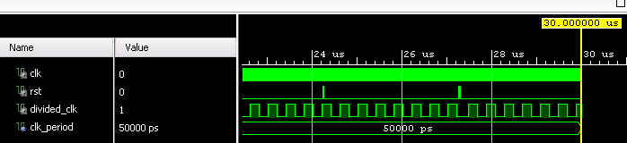

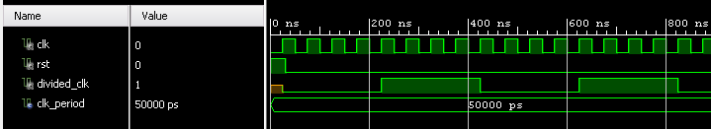

Slide 16
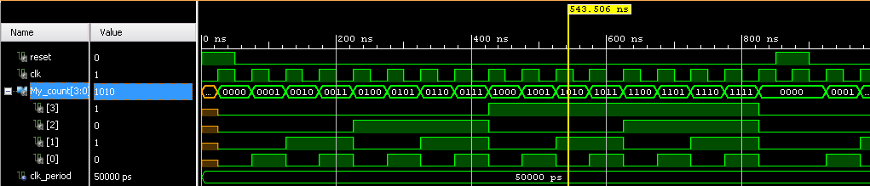
library IEEE;
use IEEE.STD_LOGIC_1164.all;
use IEEE.numeric_std.all;
use IEEE.std_logic_unsigned.all;
entity Counter is
port (reset : in std_logic;
clk : in std_logic;
My_count : out std_logic_vector(3 downto 0));
end Counter;
architecture Behavioral of Counter is
signal count : std_logic_vector(3 downto 0);
begin
counter: process (clk)
begin
if rising_edge(clk) then
if reset = '1' then
count <= (others => '0');
else count <= count + 1;
end if;
end if;
end process counter;
My_count <= count;
end Behavioral;
library IEEE;
use IEEE.std_logic_1164.all;
library xil_defaultlib;
entity for_example is
end for_example;
architecture behavior of for_example is
signal reset , clk : std_logic := '0';
signal My_count : std_logic_vector(3 downto 0);
constant clk_period : time := 50 ns;
begin
uut: entity xil_defaultlib.Counter
port map (clk, reset, My_count);
clk_generator: process
begin
clk <= '0'; wait for clk_period/2;
clk <= '1'; wait for clk_period/2;
end process clk_generator;
stim_proc: process
begin
reset <= '1'; wait for 50 ns;
reset <= '0'; wait for 100 ns;
reset <= '0'; wait for 100 ns;
reset <= '0'; wait for 100 ns;
reset <= '0'; wait for 500 ns;
end process;
end behavior;
Simulação.
Exemplo 3
(contador).

Slide 17
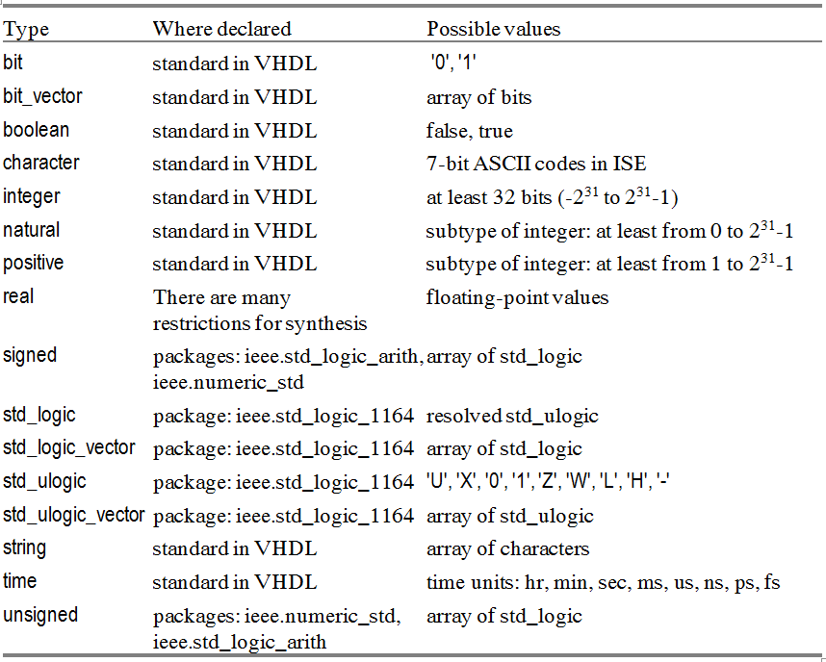
Tipos de dados, objetos e operadores
Tipos
Vamos utilizar estes tipos:
Só para simulação
O tipo record é definido por utilizador e permite criar um conjunto de dados dentro de uma estrutura

Slide 18
Tipos de dados, objetos e operadores
Vamos considerar três tipos de objetos que são:
Sinais (signal) que são declarados na parte declarativa de arquitetura.
Variáveis (variable) que são declaradas na parte declarativa de processo, função e procedimento.
Constantes (constant) que são declaradas na parte declarativa de arquitetura, processo, função e procedimento.
arquitecture <nome de arquitetura > of <nome de entidade> is
Declaração de sinais– signal
begin
Corpo de arquitetura
end <nome de arquitetura >
process (sw)
variable hwc : integer range 0 to 8;
begin
-- . . . . . . . . . . . .
end process;
architecture Behavioral of CombCircuit is
type for_test is array (0 to 3) of std_logic_vector(3 downto 0);
constant for_ex : for_test:=("0001","0010","0100","1000");
begin
-- . . . . . . . . . . . . . . . .

Slide 19
Tipos de dados, objetos e operadores
aritméticos (arithmetic) (+, -, *, /, abs, mod, rem, sign + and -, **),
concatenação (concatenation) (&),
lógicos (logic) (and, nand, nor, not, or, xnor, xor),
relacionais (relational) (=, /=, <, <=, >, >=),
atribuição (assignment) (:=, <=)
deslocamento (shift) (rol, ror, sla, sll, sra, srl).
Prioridade (precedence) :
(**),
(abs),
(not),
(*),
(/),
(mod, rem),
(+ identity, - negation),
(+,-),
(&),
(rol, ror, sll, srl),
(sla, sra),
(=,/=),
(<, <=, >, >= ),
(and, nand, nor, or, xnor, xor)

Slide 20
Instruções de controlo – decisão: if, when, with, case .
Processos combinatórios
led₀
sw₀
Circuito combinatório
led₁
led₂
sw₁
led₃
Funcionamento
00 0001
01 0010
10 0100
11 1000
sw₀ sw₁
led₃ led₂ led₁ led₀

Slide 21
Instruções de controlo – decisão: if, when, with, case .
Processos combinatórios
library IEEE;
use IEEE.STD_LOGIC_1164.all;
entity CombCircuit is
port ( sw : in std_logic_vector (1 downto 0);
led : out std_logic_vector (3 downto 0));
end CombCircuit;
architecture Behavioral of CombCircuit is
begin
led <= "0001" when sw = "00" else
"0010" when sw = "01" else
"0100" when sw = "10" else
"1000" when sw = "11" else "0000";
end Behavioral;
00 0001
01 0010
10 0100
11 1000
Utilizar dentro de arquitetura

Slide 22
Instruções de controlo – decisão: if, when, with, case .
Processos combinatórios
library IEEE;
use IEEE.STD_LOGIC_1164.all;
entity CombCircuit is
port ( sw : in std_logic_vector (1 downto 0);
led : out std_logic_vector (3 downto 0));
end CombCircuit;
architecture Behavioral of CombCircuit is
begin
with sw select led <= "0001" when "00",
"0010" when "01",
"0100" when "10",
"1000" when "11",
"0000" when others;
end Behavioral;
00 0001
01 0010
10 0100
11 1000
Utilizar dentro de arquitetura

Slide 23
Instruções de controlo – decisão: if, when, with, case .
Processos combinatórios
library IEEE;
use IEEE.STD_LOGIC_1164.all;
entity CombCircuit is
port ( sw : in std_logic_vector (1 downto 0);
led : out std_logic_vector (3 downto 0));
end CombCircuit;
architecture Behavioral of CombCircuit is
begin
process(sw)
begin
case sw is
when "00" => led <= "0001";
when "01" => led <= "0010";
when "10" => led <= "0100";
when "11" => led <= "1000";
when others => led <= "0000";
end case;
end process;
end Behavioral;
00 0001
01 0010
10 0100
11 1000
Não pode (!!!) utilizar dentro de arquitetura

Slide 24
Instruções de controlo – decisão: if, when, with, case .
Processos combinatórios
library IEEE;
use IEEE.STD_LOGIC_1164.all;
entity CombCircuit is
port ( sw : in std_logic_vector (1 downto 0);
led : out std_logic_vector (3 downto 0));
end CombCircuit;
architecture Behavioral of CombCircuit is
begin
process(sw)
begin
if sw = "00" then led <= "0001";
elsif sw = "01" then led <= "0010";
elsif sw = "10" then led <= "0100";
elsif sw = "11" then led <= "1000";
else led <= "0000";
end if;
end process;
end Behavioral;
00 0001
01 0010
10 0100
11 1000
Não pode (!!!) utilizar dentro de arquitetura

Slide 25
Utilização de constantes.
library IEEE;
use IEEE.STD_LOGIC_1164.all;
use IEEE.STD_LOGIC_UNSIGNED.all;
entity CombCircuit is
port ( sw : in std_logic_vector (1 downto 0);
led : out std_logic_vector (3 downto 0));
end CombCircuit;
architecture Behavioral of CombCircuit is
type for_test is array (0 to 3) of std_logic_vector(3 downto 0);
constant for_ex : for_test:=("0001","0010","0100","1000");
begin
led <= for_ex(conv_integer(sw));
end Behavioral;
00 0001
01 0010
10 0100
11 1000

Slide 26
Processos combinatórios
library IEEE;
use IEEE.STD_LOGIC_1164.all;
use IEEE.STD_LOGIC_UNSIGNED.all;
entity TestCombProc is
port ( sw : in std_logic_vector(7 downto 0);
led : out std_logic_vector(7 downto 0));
end TestCombProc;
architecture Behavioral of TestCombProc is
constant low : integer := 5;
constant high : integer := 10;
begin
process(sw)
begin
if (sw > low) and (sw < high) then led <= sw;
elsif sw < low then led <= not sw;
else led <= (others => '0');
end if;
end process;
end Behavioral;
led <= sw; para valores de interruptores 6,7,8,9 (“0110”, “0111”, “1000”, “1001”).
led <= not sw; para valores de interruptores 0, 1, 2, 3, 4.
Para outros valores de interruptores todos os leds são iguais a 0
Todos os sinais que podem alterar valores dentro do processo devem aparecer na lista de sensibilidade

Slide 27
Processos sequenciais.
Contador
library IEEE;
use IEEE.STD_LOGIC_1164.all;
use IEEE.STD_LOGIC_UNSIGNED.all;
use IEEE.numeric_std.all;
entity TestSeqProc is
generic ( how_fast : integer := 30);
port ( clk : in std_logic;
sw : in std_logic_vector(15 downto 0);
led : out std_logic_vector(15 downto 0);
btnL : in std_logic;
btnC : in std_logic;
btnR : in std_logic);
end TestSeqProc;
architecture Behavioral of TestSeqProc is
signal internal_clock : unsigned(how_fast downto 0);
signal divided_clk : std_logic;
signal increment : std_logic := btnL;
signal positive_reset : std_logic := btnC;
signal count_enable : std_logic := btnR;
signal count : std_logic_vector(14 downto 0);
begin
led(14 downto 0) <= count;
led(15) <= divided_clk;

Slide 28
Processos sequenciais.
Contador
sp1: process(clk)
begin
if rising_edge(clk) then internal_clock <= internal_clock+1;
end if;
if falling_edge(clk) then
divided_clk <= internal_clock(internal_clock'left - conv_integer(sw));
end if;
end process sp1;
sp2: process (divided_clk)
begin
if rising_edge(divided_clk) then
if positive_reset = '1' then count <= (others=>'0');
else
if count_enable = '1' then
if increment='0' then count <= count + 1;
else count <= count - 1;
end if;
end if;
end if;
end if;
end process sp2;
end Behavioral;

Slide 29
Processos sequenciais.
Registo de deslocamento
library IEEE;
use IEEE.STD_LOGIC_1164.all;
use IEEE.STD_LOGIC_UNSIGNED.all;
use IEEE.numeric_std.all;
entity TestSeqProc is
generic ( how_fast : integer := 30);
port ( clk : in std_logic;
sw : in std_logic_vector(15 downto 0);
led : out std_logic_vector(15 downto 0);
btnL : in std_logic;
btnC : in std_logic;
btnR : in std_logic);
end TestSeqProc;
architecture Behavioral of TestSeqProc is
signal internal_clock : unsigned(how_fast downto 0);
signal divided_clk : std_logic;
signal right : std_logic := btnL;
signal positive_reset : std_logic := btnC;
signal load_enable : std_logic := btnR;
signal shift : std_logic_vector(14 downto 0);
begin
led(14 downto 0) <= shift;
led(15) <= divided_clk;

Slide 30
Processos sequenciais.
Registo de deslocamento
sp1: process(clk)
begin
if rising_edge(clk) then internal_clock <= internal_clock+1;
end if;
if falling_edge(clk) then
divided_clk <= internal_clock(internal_clock'left);
end if;
end process sp1;
sp3: process (divided_clk)
begin
if rising_edge(divided_clk) then
if positive_reset = '1' then shift <= (others=>'0');
else
if load_enable = '1' then shift <= sw;
elsif right = '1' then
shift <= shift(0) & shift(14 downto 1);
else
shift <= shift(13 downto 0) & shift(14);
end if;
end if;
end if;
end process sp3;
end Behavioral;

Slide 31
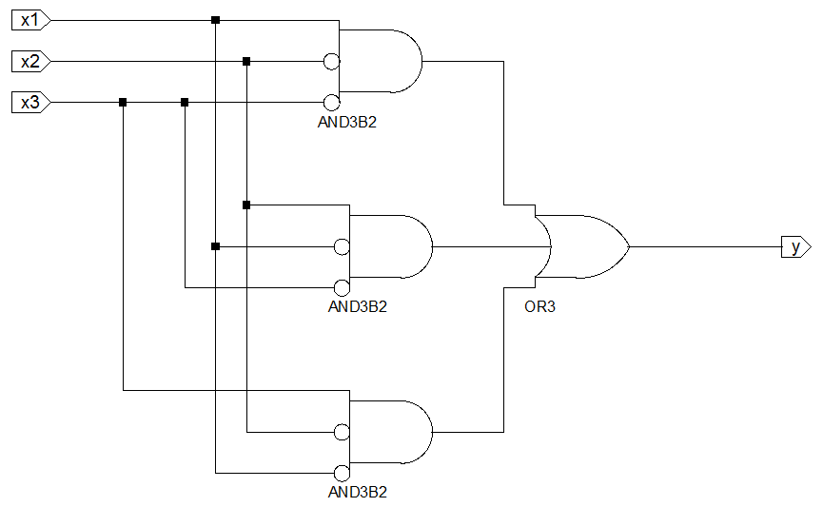
VHDL comportamental e estrutural
Descrição do comportamento semelhante à descrição na programação
library ieee;
use ieee.std_logic_1164.all;
entity behavioralVHDL is
port (x1, x2, x3 : in std_logic;
y : out std_logic);
end BehavioralVHDL;
architecture behavioral of BehavioralVHDL is
begin
y <= (x1 and not x2 and not x3) or (not x1 and x2 and not x3) or (not x1 and not x2 and x3);
end behavioral;

Slide 32
VHDL comportamental e estrutural
Permite descrever um circuito com base em componentes existentes que são incluídos na descrição. Ligações entre componentes são escritas utilizando sinais
Portos de entrada externos
Porto da saída externo
Biblioteca Xilinx UNISIM (ficheiro unisim_VCOMP.vhd). Exemplo de descrição:
component AND3B3
port ( O : out std_ulogic;
I0, I1, I2 : in std_ulogic);
end component;

Slide 33
VHDL comportamental e estrutural
library ieee;
use ieee.std_logic_1164.all;
library UNISIM;
use UNISIM.Vcomponents.all;
entity StructuralVHDL is
port ( x1,x2,x3 : in std_logic;
y : out std_logic );
end StructuralVHDL;
architecture BEHAVIORAL of StructuralVHDL is
signal out_and1 : std_logic;
signal out_and2 : std_logic;
signal out_and3 : std_logic;
begin
or_circuit : OR3
port map (I0=>out_and1, I1=>out_and2,
I2=>out_and3, O=>y);
and1_circuit : AND3B2
port map (I0=>x3, I1=>x2, I2=>x1, O=>out_and1);
and2_circuit : AND3B2
port map (I0=>x3, I1=>x1, I2=>x2, O=>out_and2);
and3_circuit : AND3B2
port map (I0=>x1, I1=>x2, I2=>x3, O=>out_and3);
end BEHAVIORAL;
component AND3B3
port (O : out std_ulogic;
I0, I1, I2 : in std_ulogic);
end component;
Biblioteca Xilinx
Mapeamento nomeado
Mapeamento posicional
begin
or_circuit : OR3
port map (out_and1, out_and2, out_and3,y);
and1_circuit : AND3B2
port map (x3, x2, x1, out_and1);
and2_circuit : AND3B2
port map (x3, x1, x2, out_and2);
and3_circuit : AND3B2
port map (x1, x2, x3, out_and3);
end BEHAVIORAL;

Slide 34
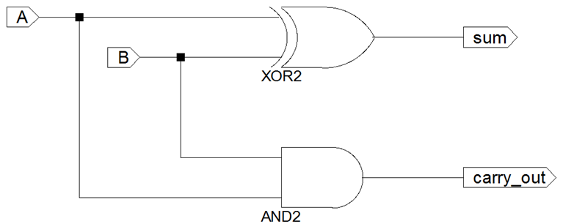
VHDL comportamental e estrutural
Half-adder
library IEEE;
use IEEE.std_logic_1164.all;
entity half_adder is
port ( A : in std_logic;
B : in std_logic;
carry_out : out std_logic;
sum : out std_logic);
end half_adder;
architecture half_adder_behavior of half_adder is
begin
sum <= A xor B;
carry_out <= A and B;
end half_adder_behavior;

Slide 35
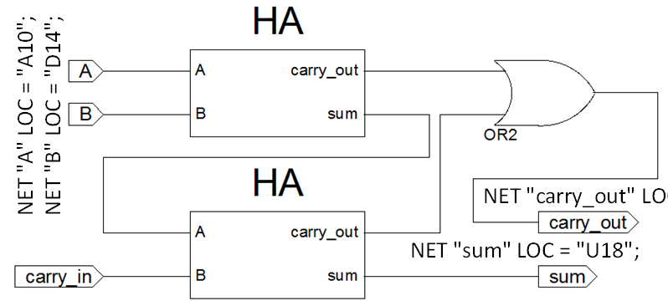
VHDL comportamental e estrutural
Half-adder (HA)
library IEEE;
use IEEE.std_logic_1164.all;
entity half_adder is
port ( A: in std_logic; B: in std_logic;
carry_out : out std_logic;
sum: out std_logic);
end half_adder;
architecture half_adder_behavior of half_adder is
begin
sum <= A xor B;
carry_out <= A and B;
end half_adder_behavior;
library IEEE;
use IEEE.std_logic_1164.all;
entity FULLADD is
port ( A, B, carry_in : in std_logic;
sum, carry_out : out std_logic );
end FULLADD;
architecture STRUCT of FULLADD is
signal s1, s2, s3 : std_logic;
component half_adder
port( A,B : in std_logic;
carry_out, sum : out std_logic);
end component;
begin
u1: half_adder port map(A, B, s2, s1); u2: half_adder port map(s1, carry_in, s3, sum);
carry_out <= s2 or s3;
end STRUCT;
Descrição mista

Slide 36
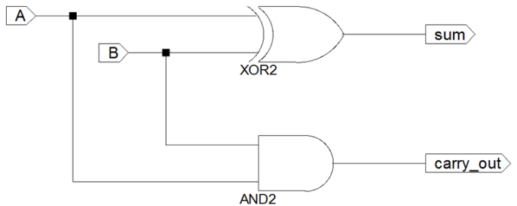
VHDL comportamental e estrutural
Half-adder (HA)
library IEEE;
use IEEE.std_logic_1164.all;
entity half_adder is
port ( A : in std_logic; B : in std_logic;
carry_out : out std_logic;
sum : out std_logic);
end half_adder;
architecture half_adder_behavior of half_adder is
begin
sum <= A xor B;
carry_out <= A and B;
end half_adder_behavior;
library IEEE;
use IEEE.std_logic_1164.all;
entity FULLADD is
port ( A, B, carry_in : in std_logic;
sum, carry_out : out std_logic );
end FULLADD;
architecture STRUCT of FULLADD is
signal s1, s2, s3 : std_logic;
component half_adder
port( A,B : in std_logic;
carry_out, sum : out std_logic);
end component;
begin
u1: half_adder port map(A, B, s2, s1); u2: half_adder port map(s1, carry_in, s3, sum);
carry_out <= s2 or s3;
end STRUCT;
library xil_defaultlib;
entity xil_defaultlib.half_adder
Descrição mista

Slide 37
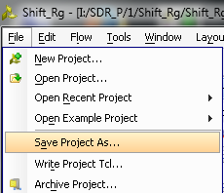
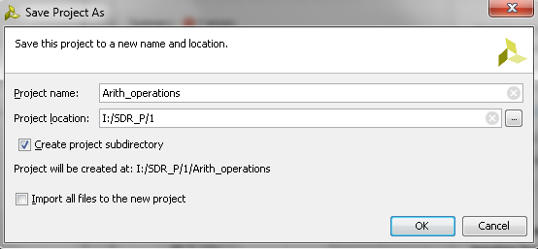
Exemplos: operações aritméticas
Pode criar em Vivado um projeto com base em qualquer projeto existente
Depois pode só alterar código VHDL e modificar o ficheiro XDC

Slide 38
Exemplos: operações aritméticas
library IEEE;
use IEEE.STD_LOGIC_1164.all;
use IEEE.STD_LOGIC_UNSIGNED.all;
use IEEE.STD_LOGIC_ARITH.all;
entity arith_op is
port ( sw : in std_logic_vector(7 downto 0);
led : out std_logic_vector(8 downto 0);
btnU, btnC, btnD, btnL, btnR : in std_logic);
end arith_op;
-- btnR division; btnL multiplication; btnD addition; btnC subtraction; btnU rest of division
architecture Behavioral of arith_op is
signal result : integer range 0 to 256;
signal but : std_logic_vector(4 downto 0);
begin
but <= btnU & btnC & btnD & btnL & btnR;
result <= 256 when conv_integer(sw(3 downto 0)) = 0 else
conv_integer(sw(7 downto 4)) / conv_integer(sw(3 downto 0))
when but = "00001" else
conv_integer(sw(7 downto 4)) * conv_integer(sw(3 downto 0))
when but = "00010" else
conv_integer(sw(7 downto 4)) + conv_integer(sw(3 downto 0))
when but = "00100" else
conv_integer(sw(7 downto 4)) - conv_integer(sw(3 downto 0))
when but = "01000" else
conv_integer(sw(7 downto 4)) rem conv_integer(sw(3 downto 0))
when but = "10000" else 0;
led(7 downto 0) <= conv_std_logic_vector(result, 8);
end Behavioral;

Slide 39
Exemplos: operações aritméticas
library IEEE;
use IEEE.STD_LOGIC_1164.all;
use IEEE.STD_LOGIC_UNSIGNED.all;
use IEEE.numeric_std.all; -- use IEEE.STD_LOGIC_ARITH.all;
entity arith_op is
port ( sw : in std_logic_vector(7 downto 0);
led : out std_logic_vector(8 downto 0);
btnU, btnC, btnD, btnL, btnR : in std_logic);
end arith_op;
-- btnR division; btnL multiplication; btnD addition; btnC subtraction; btnU rest of division
architecture Behavioral of arith_op is
signal result : integer range 0 to 256;
signal but : std_logic_vector(4 downto 0);
begin
but <= btnU & btnC & btnD & btnL & btnR;
result <= 256 when conv_integer(sw(3 downto 0)) = 0 else
conv_integer(sw(7 downto 4)) / conv_integer(sw(3 downto 0))
when but = "00001" else
conv_integer(sw(7 downto 4)) * conv_integer(sw(3 downto 0))
when but = "00010" else
conv_integer(sw(7 downto 4)) + conv_integer(sw(3 downto 0))
when but = "00100" else
conv_integer(sw(7 downto 4)) - conv_integer(sw(3 downto 0))
when but = "01000" else
conv_integer(sw(7 downto 4)) rem conv_integer(sw(3 downto 0))
when but = "10000" else 0;
led(7 downto 0) <= std_logic_vector(to_unsigned(result,8)); --led(7 downto 0) <= conv_std_logic_vector(result, 8);
end Behavioral;

Slide 40
Exemplos: processos
library IEEE;
use IEEE.STD_LOGIC_1164.all;
use IEEE.STD_LOGIC_UNSIGNED.all;
use IEEE.numeric_std.all;
entity arith_op is
port ( sw : in std_logic_vector(7 downto 0);
led : out std_logic_vector(8 downto 0);
btnU, btnC, btnD, btnL, btnR : in std_logic);
end arith_op;
-- btnR division; btnL multiplication; btnD addition; btnC subtraction; btnU rest of division
architecture Behavioral of arith_op is
signal result : integer range 0 to 256;
signal but : std_logic_vector(4 downto 0);
begin
but <= btnU & btnC & btnD & btnL & btnR;
process(but,sw)
begin
if conv_integer(sw(3 downto 0)) /= 0 then
case but is
when "00001" => result <= conv_integer(sw(7 downto 4)) / conv_integer(sw(3 downto 0));
when "00010" => result <= conv_integer(sw(7 downto 4)) * conv_integer(sw(3 downto 0));
when "00100" => result <= conv_integer(sw(7 downto 4)) + conv_integer(sw(3 downto 0));
when "01000" => result <= conv_integer(sw(7 downto 4)) - conv_integer(sw(3 downto 0));
when "10000" => result <= conv_integer(sw(7 downto 4)) rem conv_integer(sw(3 downto 0));
when others => result <= 0;
end case;
else result <= 256;
end if;
end process;
led(7 downto 0) <= std_logic_vector(to_unsigned(result,8));
end Behavioral;
Processo combinatório

Slide 41
Exemplos: conversão de tipos
signed_vector <= signed(std_logic_vector_signal);
unsigned_vector <= unsigned(std_logic_vector_signal);
std_logic_vector_signal <= std_logic_vector(signed_vector);
std_logic_vector_signal <= std_logic_vector(unsigned_vector);
Seguintes expressões devem utilizar funções de conversão:
integer_signal <= conv_integer (unsigned_vector);
integer_signal <= conv_integer (signed_vector);
integer_signal <= conv_integer (std_logic_vector_signal);
unsigned_vector <= conv_unsigned (integer_signal, size_of_unsigned_vector);
signed_vector <= conv_signed (integer_signal, size_of_signed_vector);
std_logic_vector_signal <= conv_std_logic_vector (integer_signal, size);
As funções de conversão são diferentes para pacotes diferentes
use ieee.std_logic_arith.all; → led(7 downto 0) <= conv_std_logic_vector(result, 8);
use ieee.numeric_std.all; → led(7 downto 0) <= std_logic_vector(to_unsigned(result,8));

Slide 42
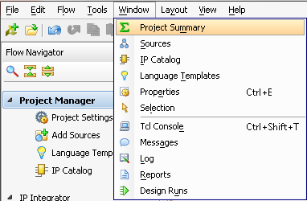

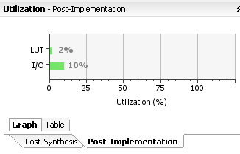
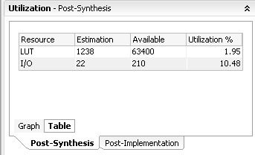
Como encontrar recursos da FPGA utilizados para o seu projeto
2
1
1 CLB = 2 slices.
1 slice = 4 LUTs e 8 flip-flops
I/O – input/output
LUT – look-up table

Slide 43
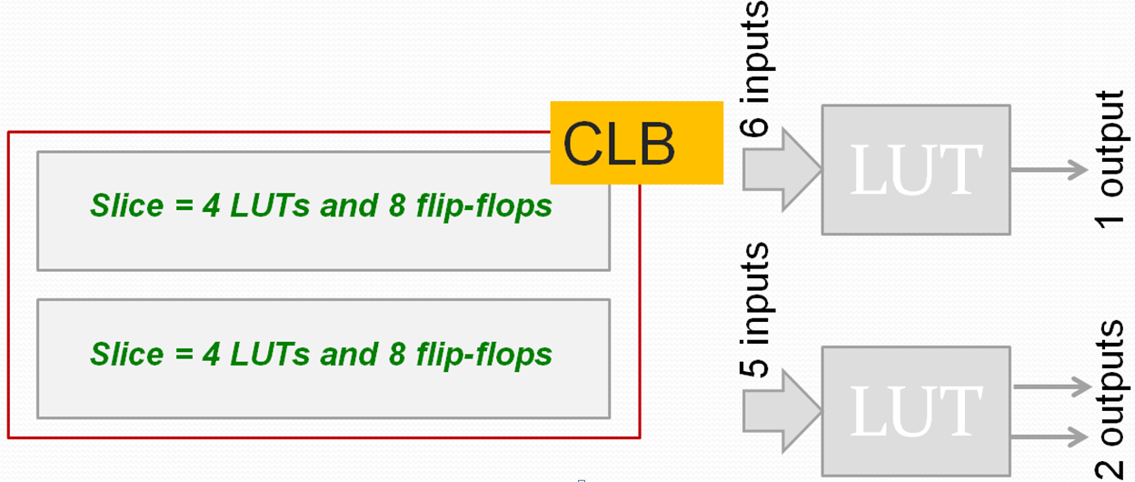
FPGA Artix-7 (família 7 de FPGAs de Xilinx)

Slide 44
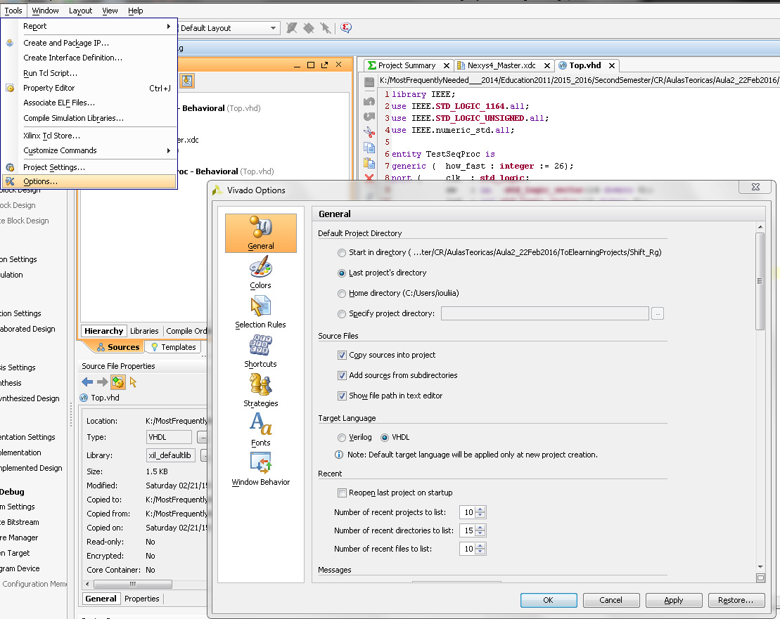

Slide 45
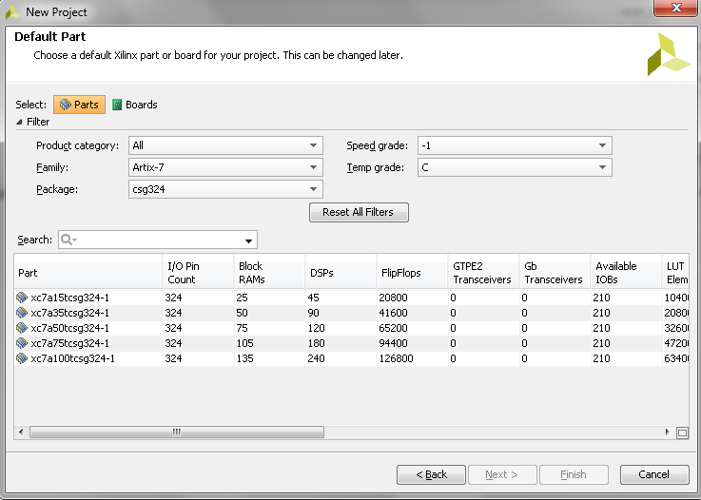

Slide 46
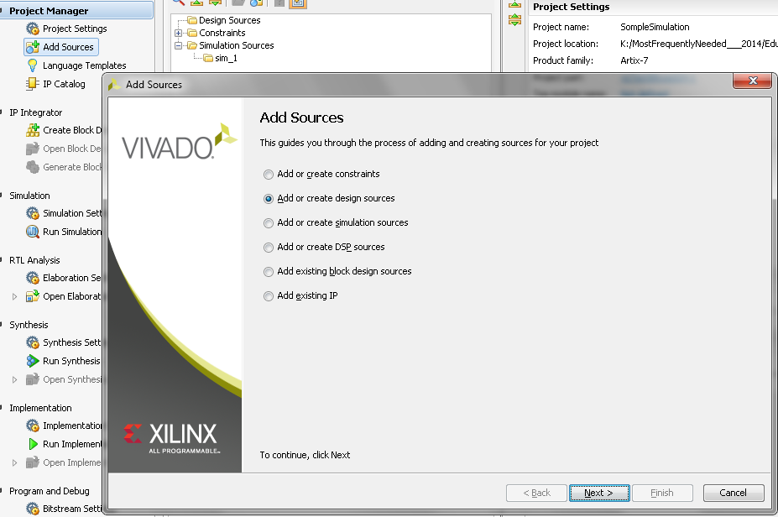

Slide 47
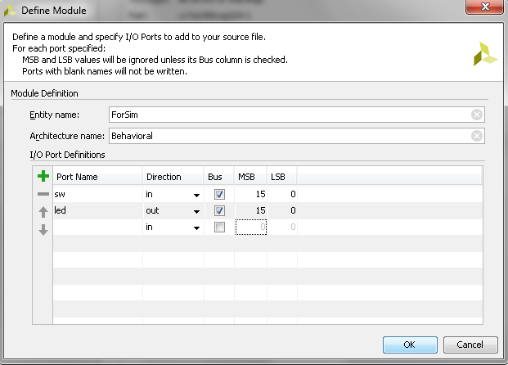
library IEEE;
use IEEE.STD_LOGIC_1164.ALL;
entity ForSim is
Port ( sw : in STD_LOGIC_VECTOR (15 downto 0);
led : out STD_LOGIC_VECTOR (15 downto 0));
end ForSim;
architecture Behavioral of ForSim is
begin
end Behavioral;

Slide 48
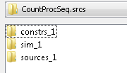
library IEEE;
use IEEE.STD_LOGIC_1164.ALL;
entity ForSim is
Port ( sw : in STD_LOGIC_VECTOR (15 downto 0);
led : out STD_LOGIC_VECTOR (15 downto 0));
end ForSim;
architecture Behavioral of ForSim is
begin
led <= not sw;
end Behavioral;

Slide 49
library IEEE;
use IEEE.STD_LOGIC_1164.ALL;
entity ForSim is
Port ( sw : in STD_LOGIC_VECTOR (15 downto 0);
led : out STD_LOGIC_VECTOR (15 downto 0));
end ForSim;
architecture Behavioral of ForSim is
begin
led <= not sw;
end Behavioral;
library IEEE;
use IEEE.std_logic_1164.all;
library xil_defaultlib;
entity for_example is
end for_example;
architecture behavior of for_example is
signal ssw : STD_LOGIC_VECTOR (15 downto 0);
signal lled : STD_LOGIC_VECTOR (15 downto 0);
-- constant clk_period : time := 50 ns;
begin
uut: entity xil_defaultlib.ForSim
port map (sw=>ssw, led=>lled);
--clk_generator: process
--begin
-- clk <= '0'; wait for clk_period/2;
-- clk <= '1'; wait for clk_period/2;
--end process clk_generator;
stim_proc: process
begin
ssw <= "1111111100000000"; wait for 100 ns;
ssw <= "0101010101010101"; wait for 100 ns;
end process;
end behavior;

Slide 50
